Slide 1
Putting Active Directory
Into Source Control
Introduction to the
Active Directory Management Framework

Slide 2

Many thanks to our sponsors:

Slide 3

about_speaker
Name: Fred
Customer Engineer @MSFT
GitHub: github.com/FriedrichWeinmann
Twitter: @FredWeinmann
PS Discord / PS Slack: Fred
Projects: PSFramework.org | admf.one

Slide 4
Scope

Slide 5
In Scope:
Deploy & Manage Topology
Green Field
Brown Field
Latrine
Continual Process
Execute Project
Analyze for Best Practices*
Compromise Recovery
Security Policy Management
Delegation Analysis
Documenting Change
Logging**
Single Domain & Forest
Hundreds of Forests
Local Execution
Bastion Forest

Slide 6
Out of Scope:
Daily operations
Regular user accounts
Client computers
Other items in constant flux
Auditing Actual Change

Slide 7
The Problem

Slide 8
Changelog: Active Directory in Server 2022
…
Notes:
Administrative Practices have changed about the same amount

Slide 9
Active Directory Projects
Manual Labor
Architect
Production Environment
Test Environment
Automation
Tools
The Plan

Slide 10
On the topic of Environments …
Production Environment 2
Production Environment 3
!=
Test Environment
Production Environment
Production Environment 4
Production Environment 5

Slide 11

Once upon a time …
The Plan
Notes:
Two Years Later
Plan only documentation, but environment moved on

Slide 12


Custom Development / Scripting

Slide 13

Consequences
"Wrong" Author
Redundant Code
Incompatibility
High Maintenance
Lengthy Projects

Slide 14
The new Workflow

Slide 15
The Management Process
Test Environment
Test
Apply
ADMF
Changes
Test
Architect
The Plan
Apply
Production Environment
Test
Apply
Changes
Production Environment 1
Changes
Production Environment n

Slide 16
Architecture

Slide 17
Contexts
Prod
Hyper-V
Forest
Contoso
Default
QA
Root Domain
Dev
Break Glass
Child Domain

Slide 18
The Context
Context A
GPO
Schema
Extension
Access Rules
Dependencies
Mutual
Exclusion
User
Sites
GP Link
Other
Metadata
Groups
OUs
…

Slide 19
Combining multiple Contexts
Schema Ext.
GPO
Groups
Access Rules
Group Member

Slide 20
Turning code
New-ADUser -SamAccountName 'Captain.Microsoft' `
-GivenName 'Mark' `
-Surname 'Russinovich' `
-Description “They might call it the cloud but it is, in fact, just someone else’s computer."
-PasswordNeverExpires $false
-Path "OU=Users,DC=contoso,DC=com"
-UserPrincipalName Captain.Microsoft@contoso.com

Slide 21
Turning code into configuration
{
"SamAccountName": "Captain.Microsoft",
"GivenName": "Mark",
"Surname": "Russinovich",
"Description": "They might call it the cloud but it is, in fact, just someone else’s computer.",
"Path": "OU=Users,DC=contoso,DC=com",
"UserPrincipalName": "Captain.Microsoft@contoso.com"
}

Slide 22
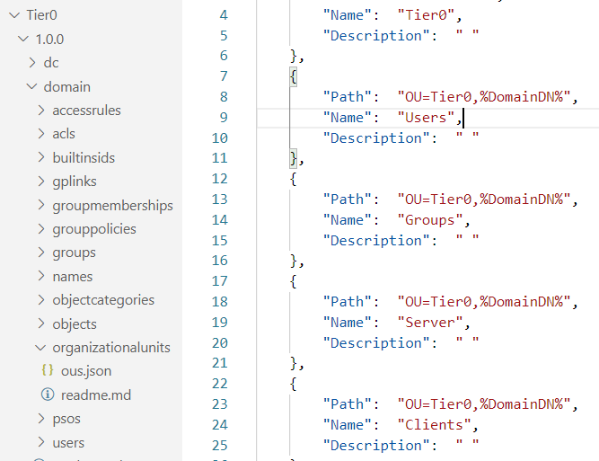
Turning code into configuration that scales

Slide 23
Demo

Slide 24
Q&A
15 minutes

Slide 25
Microsoft Graph is the large new modern API to access Microsoft 365 data. Developing with Graph can be fun, but like every API it requires actions to make a script or program secure. This sessions shows common mistakes and gives tipps how to secure your own Graph API PS Script. It will cover topics like permission models, CBA, CA, scoping and more.

Slide 26
Slide title
Sample text for your PSConf.EU 2022 presentation
We usually prefer demos, use slides with moderation
Think about those at the back of the room, some text might be too small.
Think about accessibility, try to improve the contrast, colours and size of your presentation.

Slide 27
Instructions
Use this template if you want, it’s preferred but not mandatory.
Please make sure our sponsors are mentioned on your first slide after the title.
Do not amend the ratio or the colours of the sponsors’ logo and background.
Update your twitter handle through the master page (see next slides).

Slide 28
Instruction (Continued)
The session is 30 min.
Then 15min Q&A.
At the end of your 45 min, please leave the room to the next speaker.
You’re welcome to continue the discussion in the Foyer area.

Slide 29
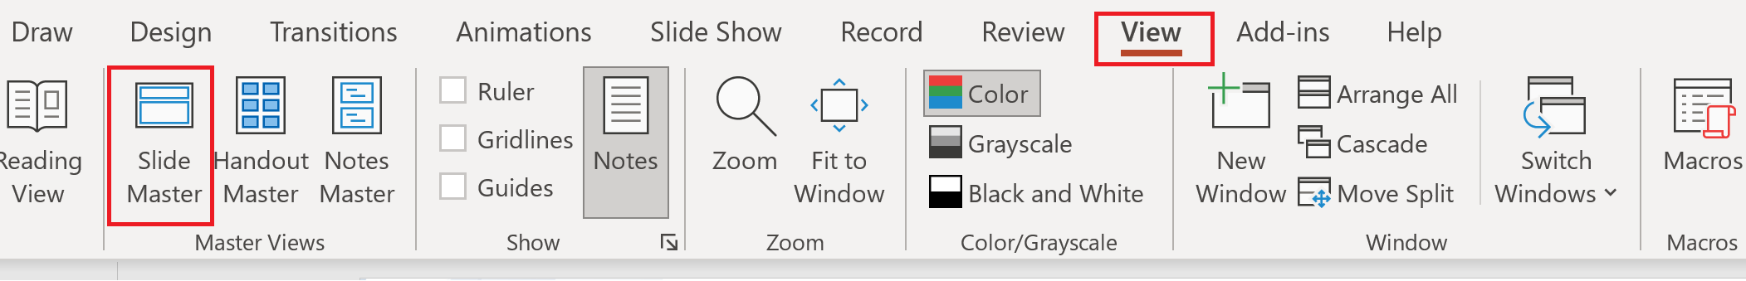
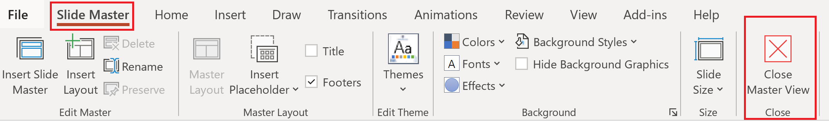
Update the twitter handle on the master slide
To open the slide master:
To close the Master view:
If you need any help, do not hesitate to email us at psconfeu@synedgy.com

Slide 30
Demos
We love Demos!

Slide 31
Q&A
15 minutes

